Slide 1

Earthquakes and GDP
By Kyla Gelev, Ken Yeh,
Tiffany Cheng, Aaron Karpie

Slide 2


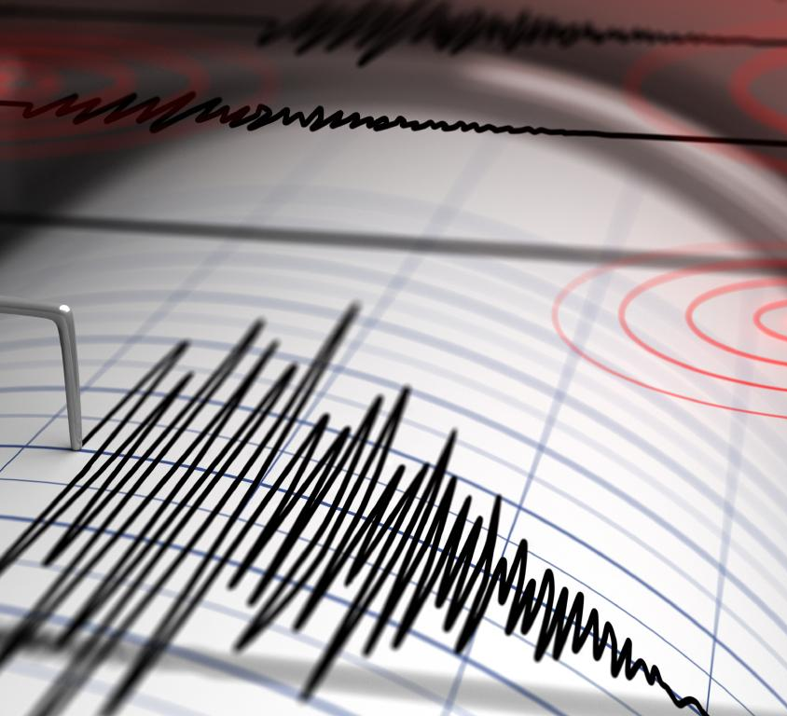
Objectives
Questions and Hypothesis
Data Sources
Data Cleaning
Flask Implementation
General Earthquake Information
Heatmap of Earthquake Sample
Top 5 Earthquake from 2000 to present
Indonesia (3)
Chile
Japan
Global Impact
Conclusion & Key Observation
Post Mortem

Slide 3
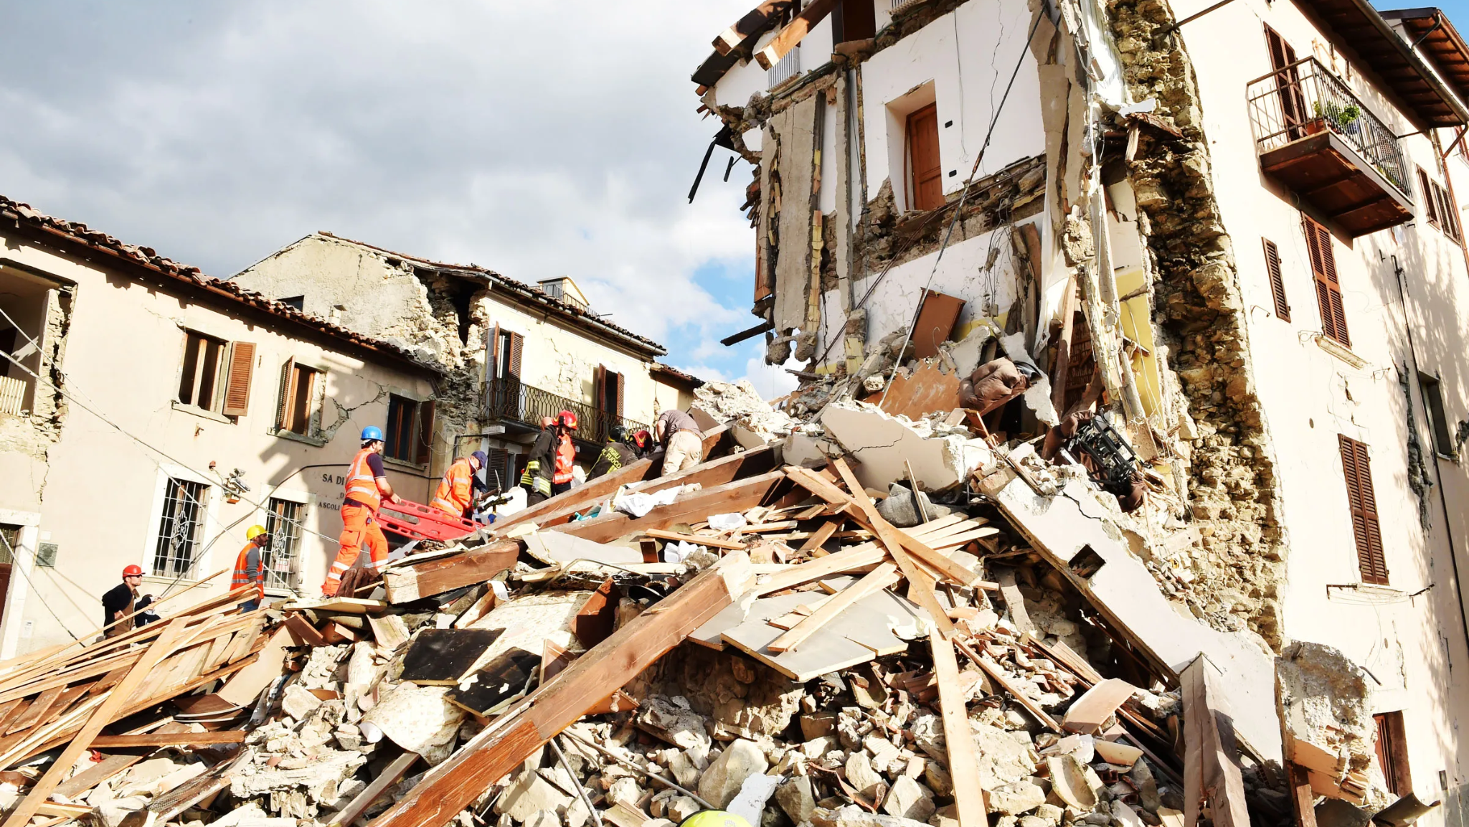
Question and Hypothesis
Overall: What are key traits to major Earthquakes and how do major Earthquakes impact the global economy?
Top 5 Earthquakes within the last 20 years?
Where are the active fault lines?
Correlation between Magnitude vs Depth?
Global and Local Economic impacts of Earthquakes?
Notes:
Top 5 earthquakes in magnitude within the last 20 years?
Are earthquakes concentrated in certain areas of the world?
Is there a correlation between specific traits of an earthquake (i.e. magnitude and depth)?
Is GDP, GDP Per Capita, and GDP growth affected by major disasters, specifically earthquakes?
How are other major countries impacted by a major earthquake?

Slide 4

Data Sources
USGS: https://earthquake.usgs.gov/fdsnws/event/1/
World Bank: https://data.worldbank.org/indicator/NY.GDP.MKTP.PP.KD?end=2019&start=1991

Slide 5

Variables
Population: Earthquakes recorded by USGS:
> 7.0 Magnitude
From 2000 to Present
Measure of Economy:
GDP
GDP Growth
GDP per capita

Slide 6
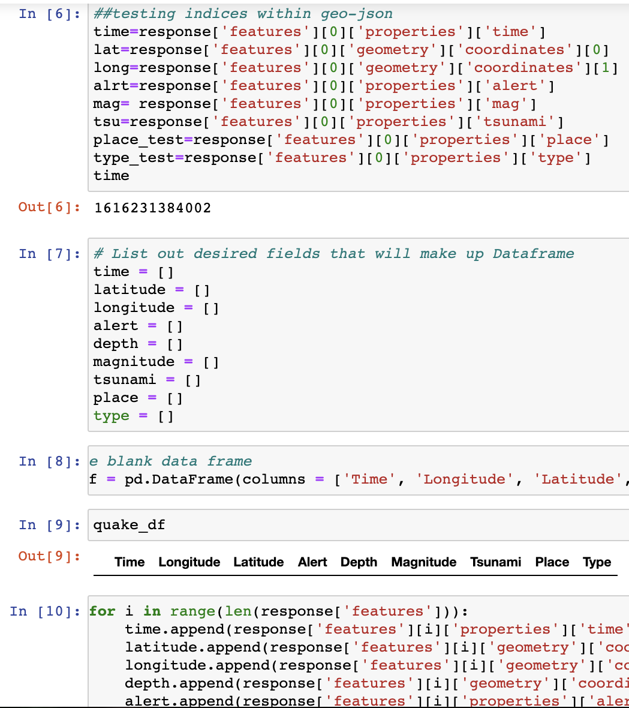

Data Cleaning
Used Pandas to read csv
Performed data validation
Sorted values based on Magnitude
Convert Time values
Loaded into SQL database
Notes:
Read csv files into dataframes using pandas
Performed data validation and dropped unnecessary columns
Sorted values based on Magnitude
Convert Time values
Loaded into SQL database

Slide 7

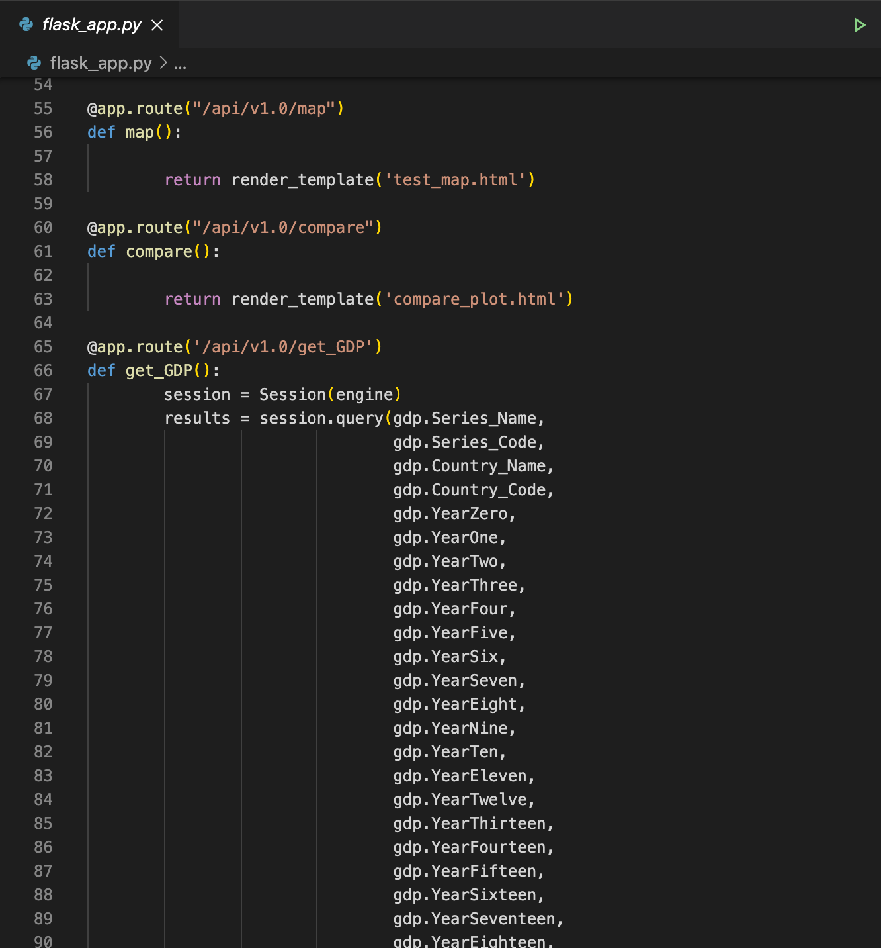
Loaded database created in SQL into SQLite
Using python created flask app
Notes:
Loaded database created in SQL into SQLite
Using python created flask app with routes to run html pages and retrieve data for visualizations

Slide 8
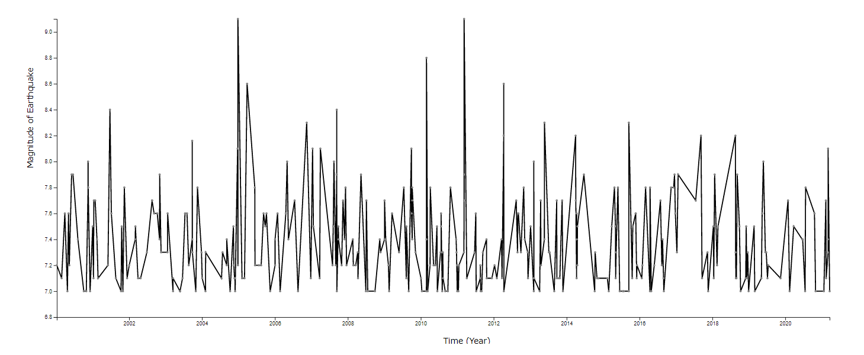
Visualizations - Earthquakes
Earthquake Magnitudes from 2000 to Present
Observations: Relatively Equally Distributed through time frame; Slight Negative Correlation between Magnitude and Time since no Earthquake greater than 8.3 Magnitude within last 8 years

Slide 9
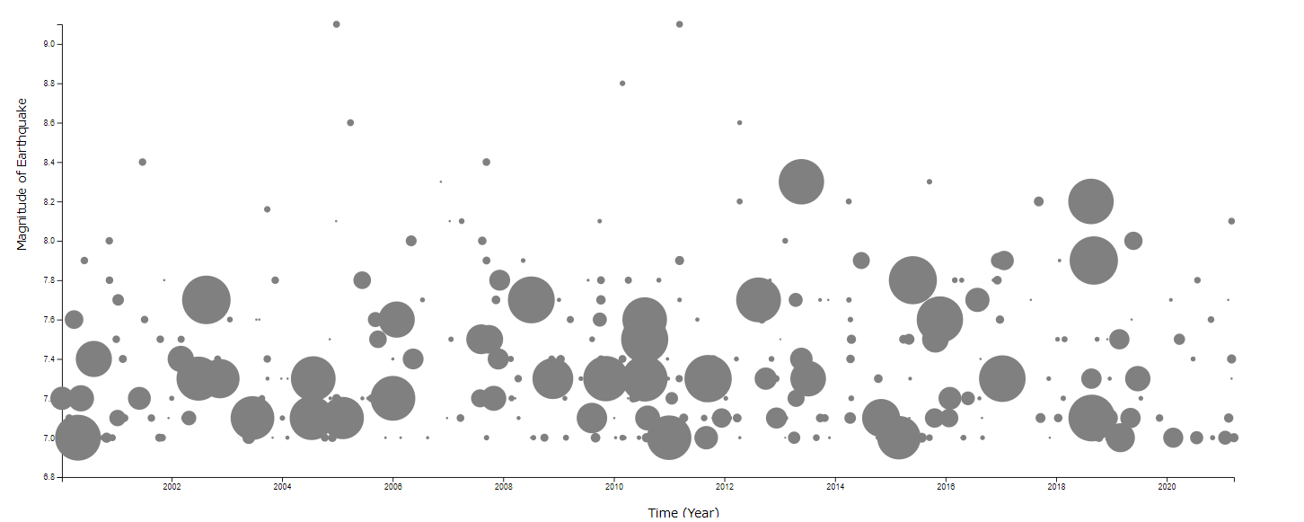
Key Earthquake Characteristics: Depth
Correlation: Magnitude v. Depth
Observation: Earthquakes with magnitudes higher than 8.4 have significantly lower depth than those with lower magnitudes

Slide 10
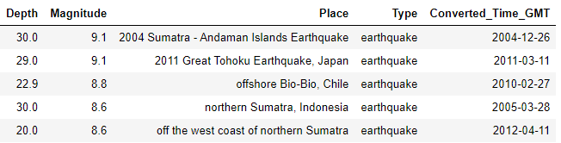
Top 5 Earthquakes in Magnitude
Identifying the key earthquake for focus analysis on countries:
Indonesia (3)
Japan (1)
Chile (1)

Slide 11
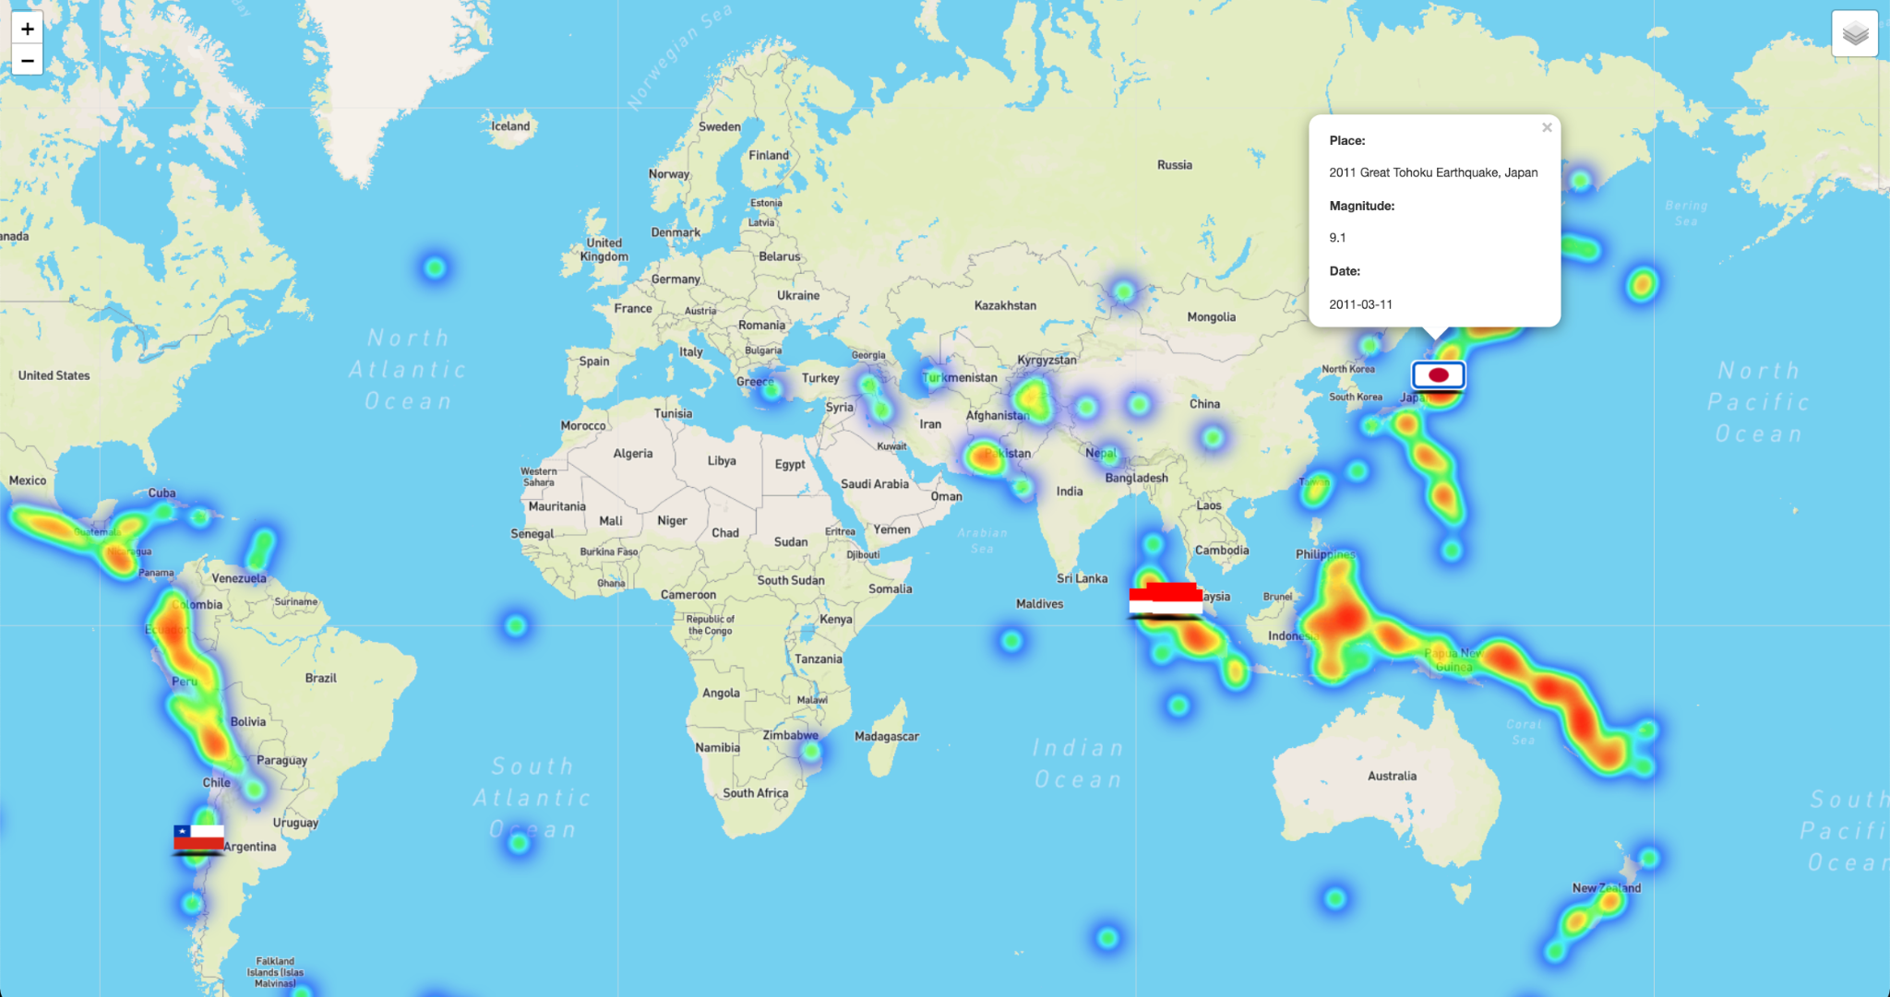
Visualizations - Heat Map
Correlation: Areas with concentrated Earthquake v. Top 5 Earthquakes

Slide 12
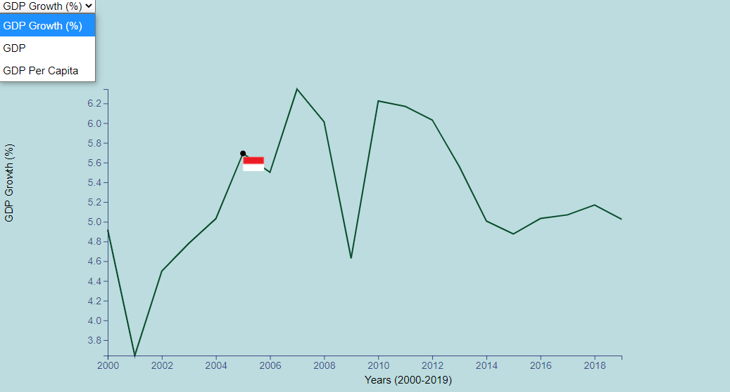
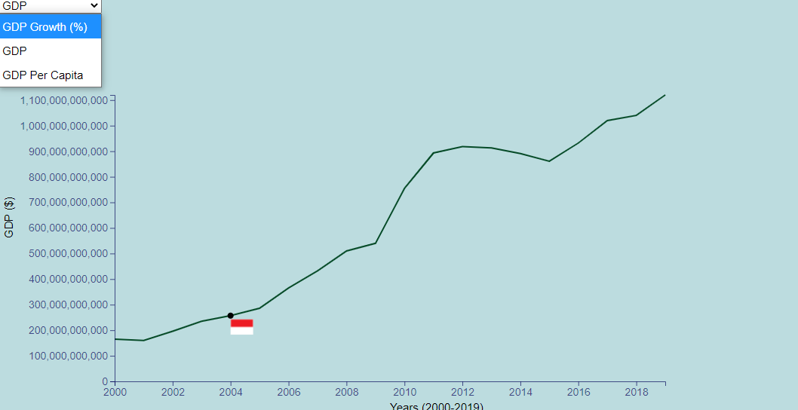
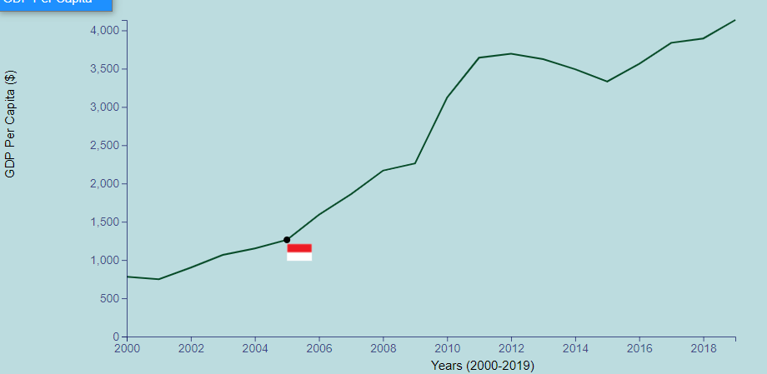
Visualization - Indonesia (2004)
2004
GDP Per Capita :~$1,150
GDP Growth: 5.04%
GDP: $257B
2005
GDP Per Capita:~$1,262
GDP Growth: 5.69%
GDP: $286B
2006
GDP Per Capita:~$1,589
GDP Growth: 5.50%
GDP: $365B
Notes:
As we saw in the heatmap there is strong seismic activity in South East Asia particularly around Sumatra (Province of Indonesia) which lies at the border of two of Earth’s shifting tectonic plates. The first instance we observed was the 2004 Earthquake in Sumatra which registered at 9.1 in Magnitude (highest of the past 20 years) and created a series of destructive tsunamis, killing over 200,000 people. Sumatra being a province of Indonesia, we thought it best to observe Indonesia’s economic reaction.
Analysis: The event occurred at the tail end of 2004, so it was important to observe subsequent years to truly assess if there was any substantial economic impact. Just for reference GDP in 2004 was $257T, GDP growth 5.69%, GDP Per Capita $1,150. Subsequent years of 2005 and 2006, showed GDP Per Capita $1,262 and $1,589 respectively, GDP growth of 5.69% and 5.50% respectively, and GDP increases of $286T and $365T respectively. In other words, there didn’t appear to be an economic impact as evidenced by subsequent years, as gdp increased on both a raw and per capita basis.

Slide 13
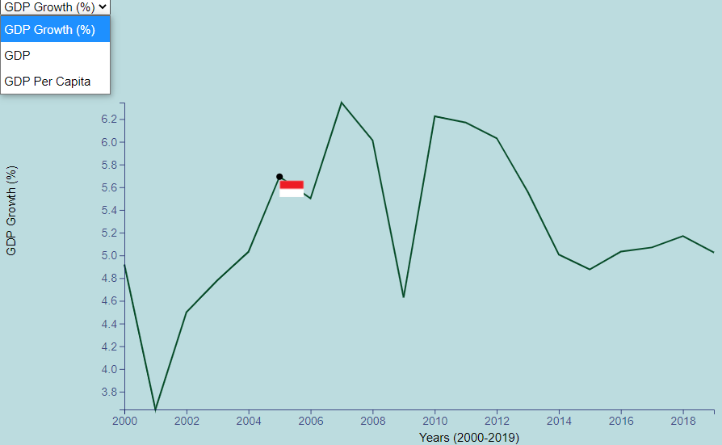
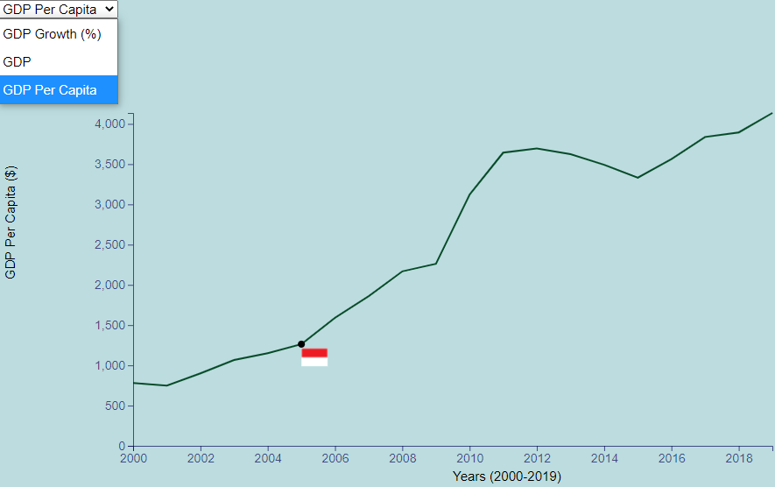
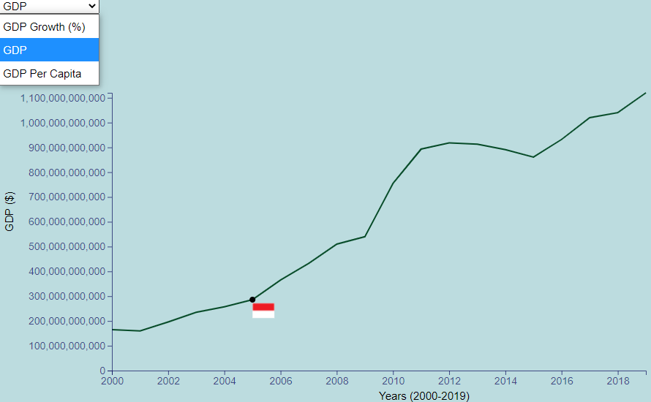
Visualization - Indonesia (2005)
2005
GDP Per Capita:~$1,262
GDP Growth: 5.69%
GDP: $286B
2006
GDP Per Capita:~$1,589
GDP Growth: 5.50%
GDP: $365B
2007
GDP Per Capita: $1,860
GDP Growth: 6.34%
GDP: $432B
Notes:
As we saw in the heatmap there is strong seismic activity in South East Asia particularly around Sumatra (Province of Indonesia) which lies at the border of two of Earth’s shifting tectonic plates. The first instance we observed was the 2004 Earthquake in Sumatra which registered at 9.1 in Magnitude (highest of the past 20 years) and created a series of destructive tsunamis, killing over 200,000 people. Sumatra being a province of Indonesia, we thought it best to observe Indonesia’s economic reaction.
Analysis: The event occurred at the tail end of 2004, so it was important to observe subsequent years to truly assess if there was any substantial economic impact. Just for reference GDP in 2004 was $257T, GDP growth 5.69%, GDP Per Capita $1,150. Subsequent years of 2005 and 2006, showed GDP Per Capita $1,262 and $1,589 respectively, GDP growth of 5.69% and 5.50% respectively, and GDP increases of $286T and $365T respectively. In other words, there didn’t appear to be an economic impact as evidenced by subsequent years, as gdp increased on both a raw and per capita basis.

Slide 14
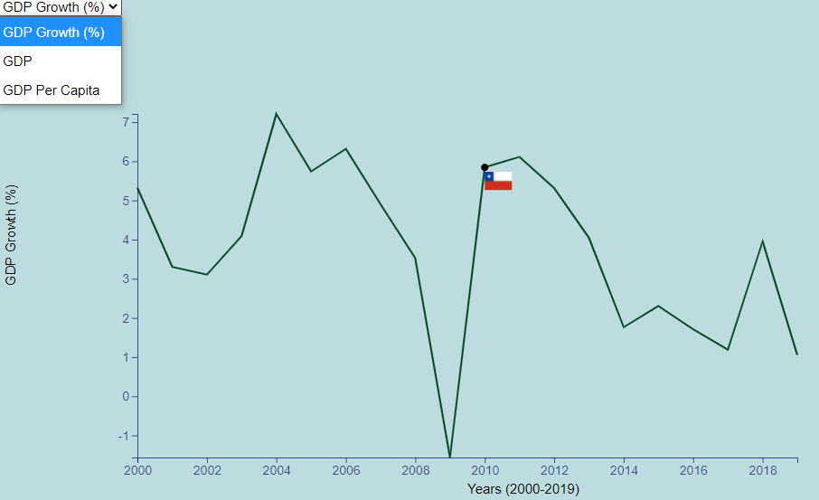
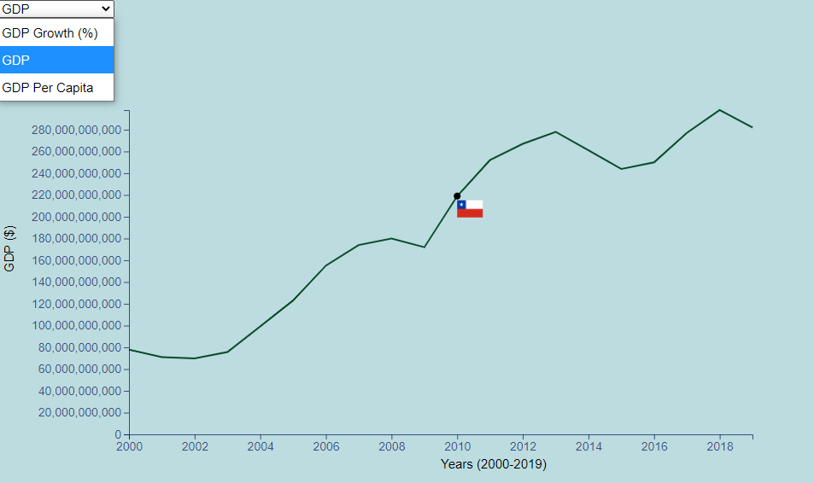
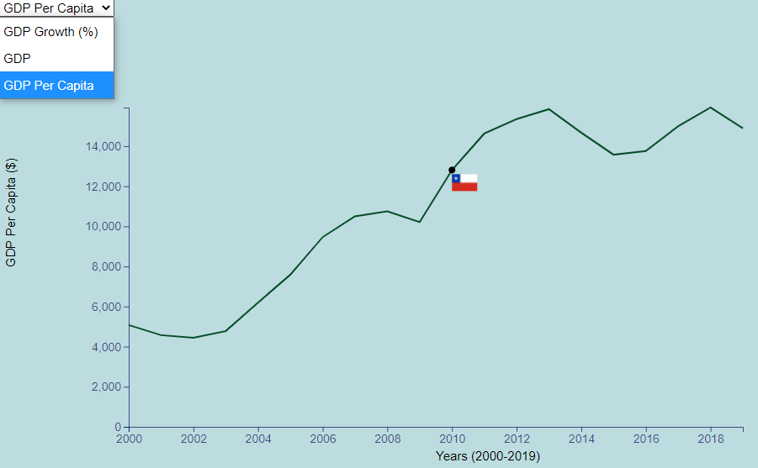
Visualization - Chile (2010)
2010
GDP Per Capita :~$12,808
GDP Growth: 5.84%
GDP: $219B
2011
GDP Per Capita:~$14,637
GDP Growth: 6.11%
GDP: $252B
2012
GDP Per Capita:~$ 15,351
GDP Growth: 5.31%
GDP: $ 267B

Slide 15
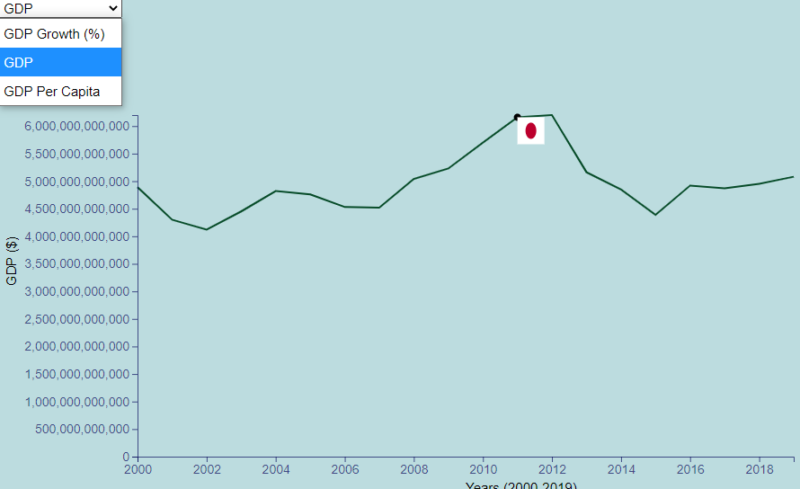
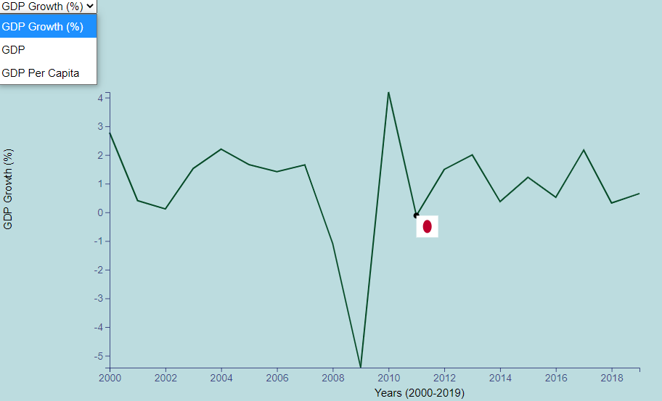
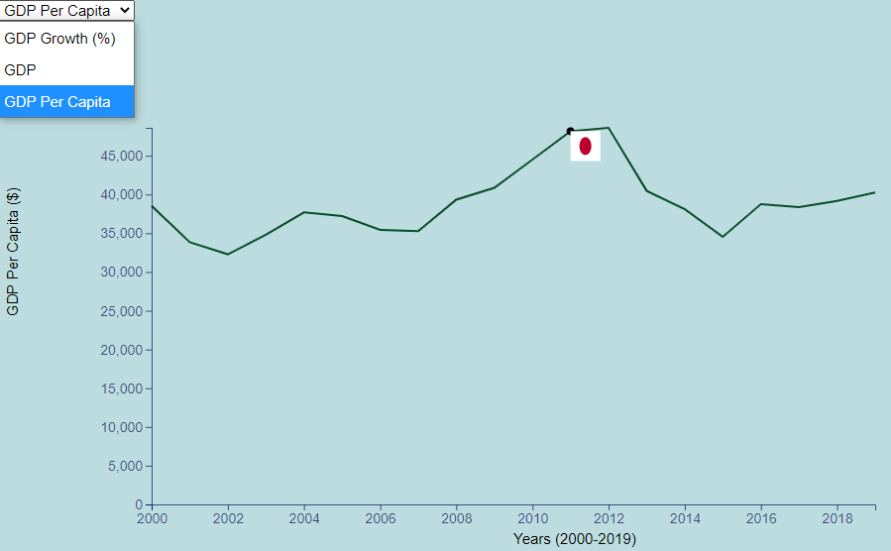
Visualization - Japan (2011)
2011
GDP Per Capita :~$48,167
GDP Growth: -0.11%
GDP: $616T
2012
GDP Per Capita:~$48,603
GDP Growth: 1.49%
GDP: $620T
2013
GDP Per Capita:~$40,454
GDP Growth: 2.0%
GDP: 516T

Slide 16
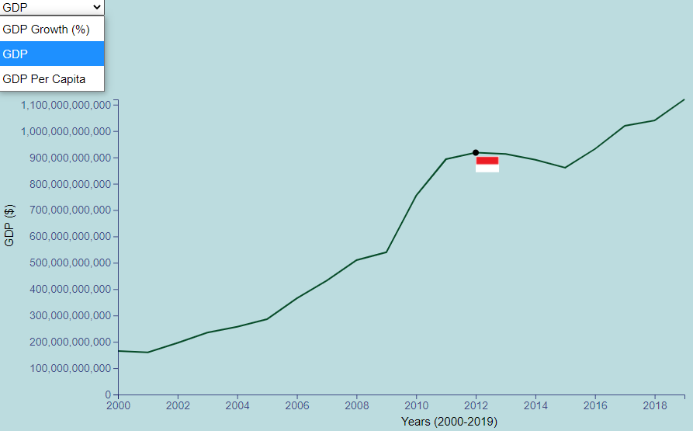
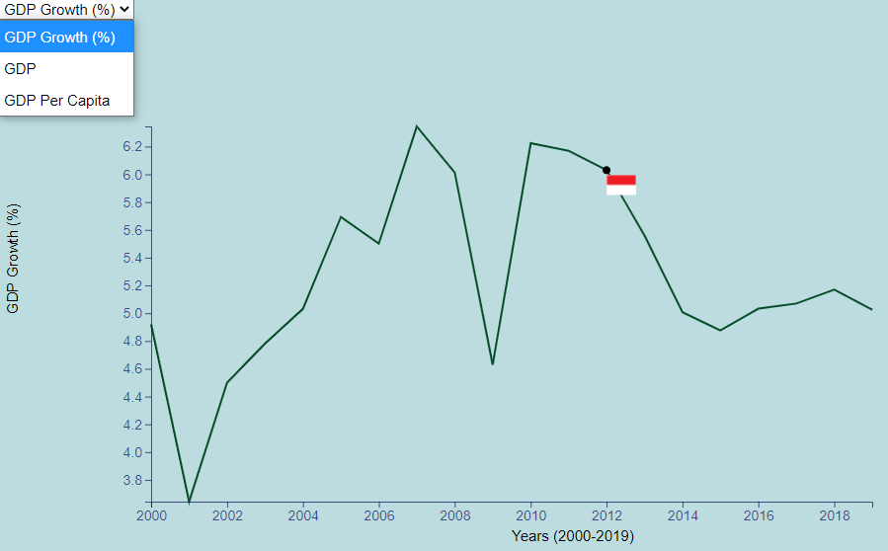
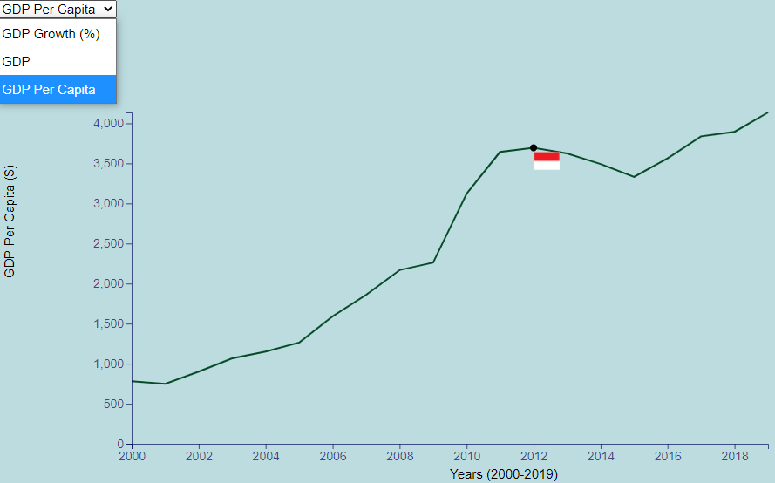
Visualization - Indonesia (2012)
2012
GDP Per Capita :~$3,694
GDP Growth: 6.03%
GDP: $918B
2013
GDP Per Capita:~$3,623
GDP Growth: 5.55%
GDP: $913B
2014
GDP Per Capita:~$3,491
GDP Growth: 5.00%
GDP: $891B

Slide 17
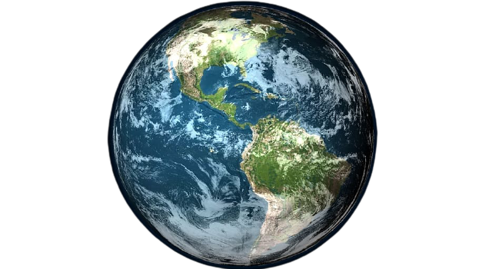
Global Impact
Economies to observe global impact
Brazil (BRA)
China (CHN)
UK (GBR)
India (IND)
Russia (RUS)
United States of America (USA)
Notes:
Reason for choosing these countries
https://www.investopedia.com/terms/b/bric.asp
In future years, Brazil Russia, India, and China will be the dominant suppliers of goods
UK in the past was a major superpower, now no longer considered
USA now is major superpower

Slide 18
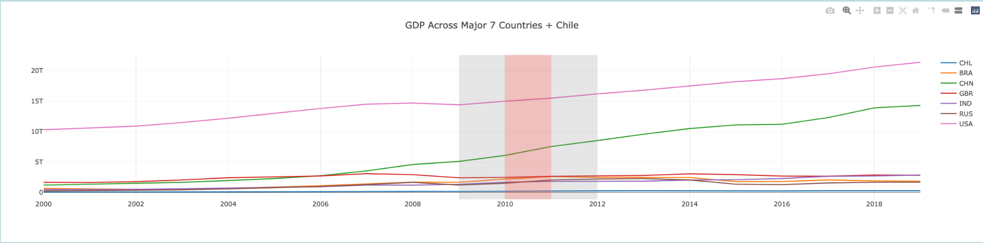
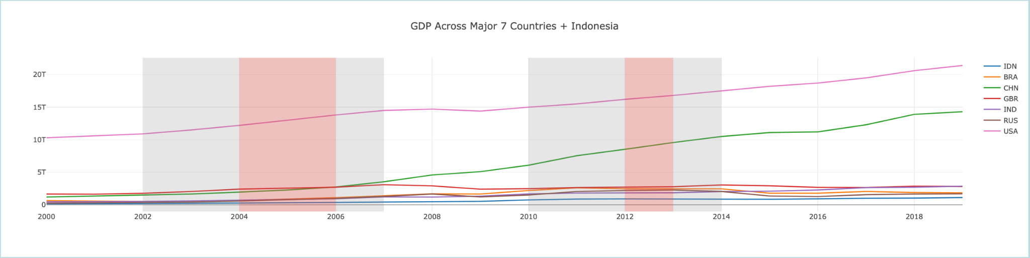
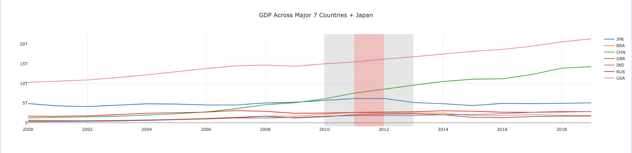
Global Impact
USA and China seem largely unaffected with steady GDP climb

Slide 19
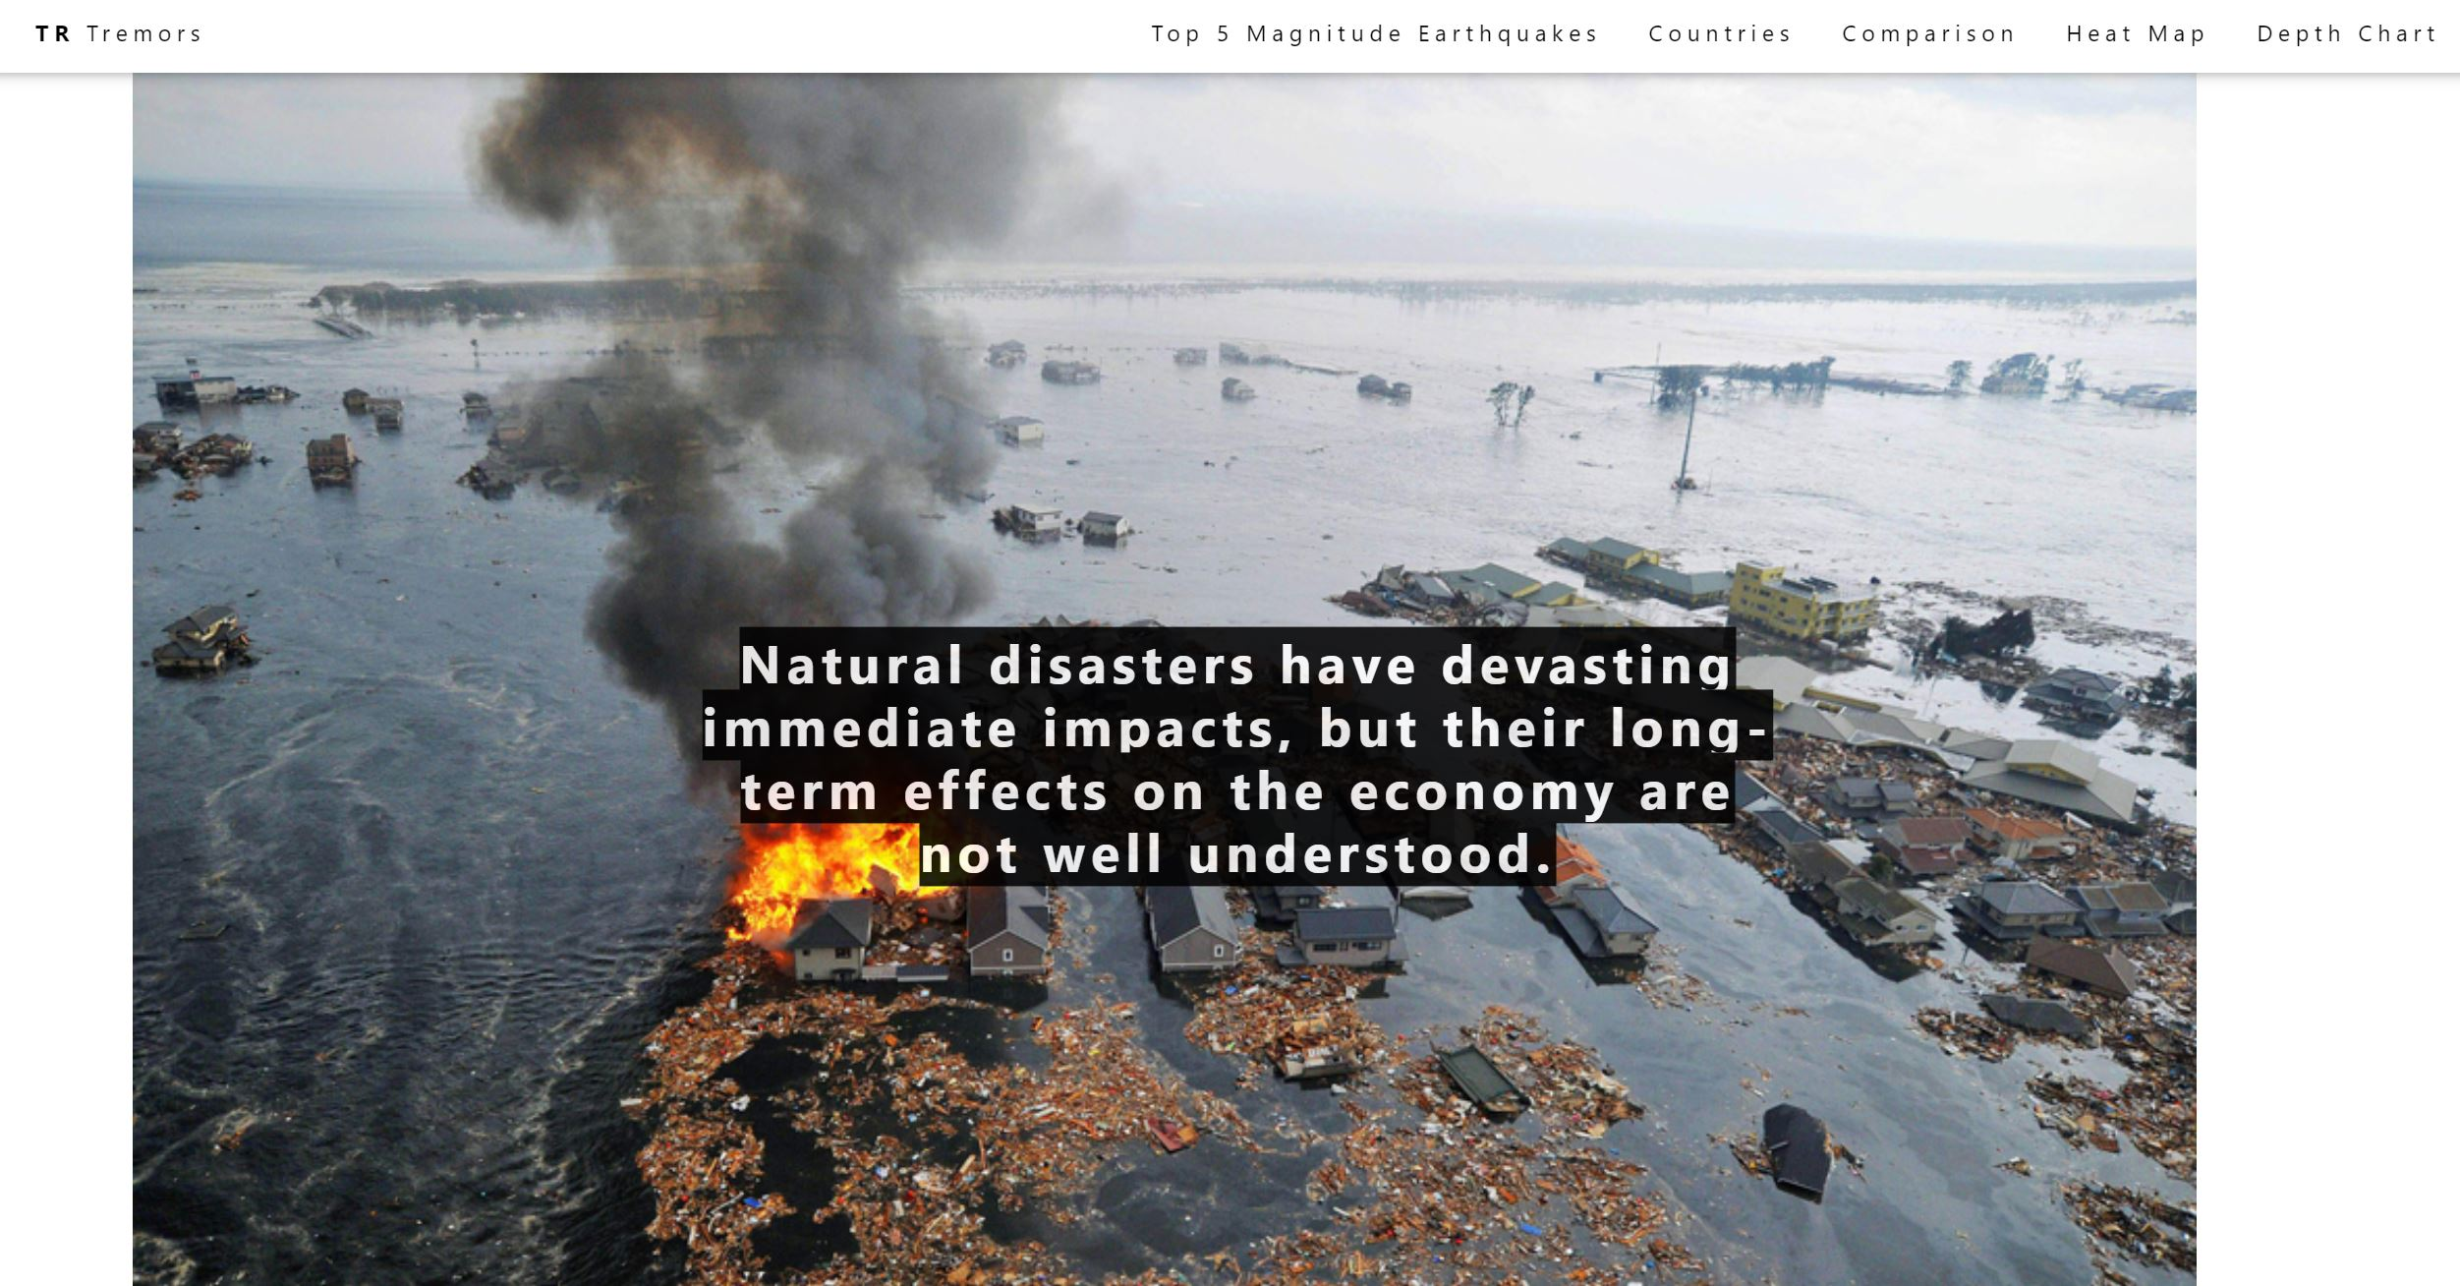
Web Page Demo

Slide 20
Conclusion & Key Observations
No significant increase or decrease of earthquakes observed in last 20 years
Higher depth correlated to lower magnitudes
“Developed” nation (Japan) vs “Developing” (Indonesia/Chile) GDP impact.

Slide 21
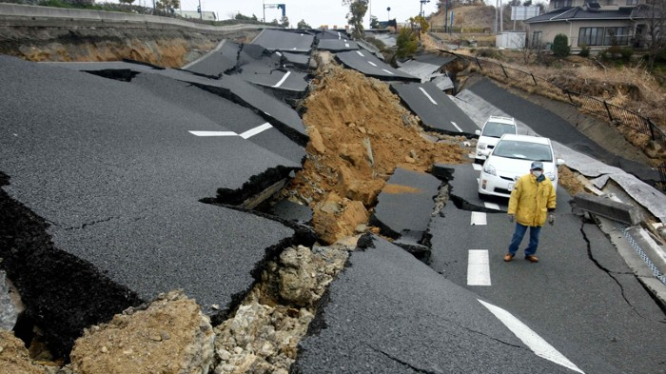
Post Mortem
Difficulties faced
USGS API limitations in amount of earthquake data sampled
Cannot isolate other events that may largely impact GDP/Economic Growth
GDP is very high-level measure of Economic Growth and cannot measure on a micro-level
Flask Connection to Visualizations
Things to look in the Future
Other key Earthquake traits and Macroeconomic Variables to consider (i.e. Tsunami, Type of Tectonic Movements, Population, Development, etc.)
Further Analysis on Other Aspects (i.e. Cost Incurred, Financial Aid Received, Housing Prices, Development)
Incorporate Statistical Analysis and Machine Learning

Slide 22

Q & A

